Slide 1


MODULE-5 COLLECTIONS

Slide 2
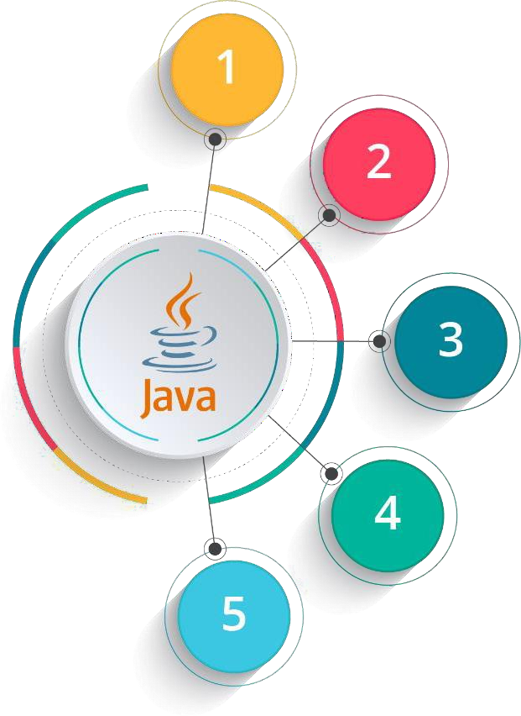
Objectives
Introduction to Java
Data Handling and Functions
Object Oriented Programming in Java
Packages and Multithreading
Collections

Slide 3


Objectives
At the end of this module, you will be able to
→ Identify and use important Inbuilt Java Packages like java.lang, java.io, java.util etc.
→ Use Wrapper classes
→ Understand collections framework
→ Implement logic using ArrayList and Vector and Queue
→ Use set, HashSet and TreeSet
→ Implement logic using Map HashMap and Hashtable

Slide 4
Object Level Locking
Object level locking is mechanism when you want to synchronize a non-static method or non-static code block such that only one thread will be able to execute the code block on given instance of the class.
This should always be done to make instance level data thread safe.
public class Dursikshya
{
public synchronized void
demoMethod(){}
}
public class Dursikshya
{
private final Object lock = new
Object();
public void demoMethod(){
synchronized (lock)
{
//other thread safe code
}
}
}
public class Dursikshya
{
public void demoMethod(){
synchronized (this)
{
//other thread safe code
}
}
}

Slide 5
Class Level Locking
Class level locking prevents multiple threads to enter in synchronized block in any of all available instances on runtime. This should always be done to make static data thread safe.
public class Dursikshya
{
public synchronized static
void demoMethod(){}
}
public class Dursikshya
{
private final static Object lock = new
Object();
public void demoMethod(){
synchronized (lock)
{
//other thread safe code
}
}
}
public class Dursikshya
{
public void demoMethod(){
synchronized (Dursikshya.class)
{
//other thread safe code
}
}
}

Slide 6
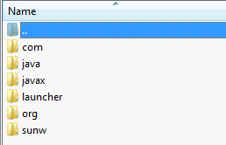
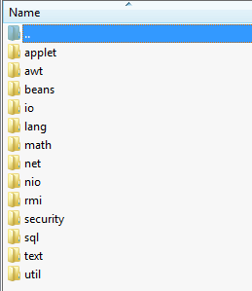
Inbuilt Java Packages
java.io java.lang
Important Inbuilt packages
java.util

Slide 7
java.lang
→ This package provides the classes which are fundamental to Java language.
→ Some of the classes in this package are:
» Byte, Character, Integer, Long, Float – Wrapper classes.
» Math, String, StringBuffer, StringBuilder
» System
» Thread
» Exceptions

Slide 8
java.lang
Math - The class Math contains methods for performing basic numeric operations such as the elementary exponential, logarithm, square root, and trigonometric functions.
String - The String class represents character strings. All string literals in Java programs, such as "abc", are implemented as instances of this class.
StringBuffer - A thread-safe, mutable sequence of characters. A string buffer is like a String, but can be modified. At any point of time, it contains some particular sequence of characters, but the length and content of the sequence can be changed through certain method calls.
StringBuilder - A mutable sequence of characters. This class provides an API compatible with StringBuffer, but with no guarantee of synchronization.
System - The System class contains several useful class fields and methods for standard input, standard output, and error output streams etc. It cannot be instantiated.
Thread - A thread is a thread of execution in a program.
Exceptions - The class Exception and its subclasses are a form of Throwable that indicates conditions that a reasonable application might want to catch.
Note: These classes has been covered in the previous modules

Slide 9

java.util
Collections are very important in Java programming.
→ This package has all the utility classes required in Java program.
→ All the collection classes which will be discussed in the next slides are part of java.util.
→ Apart from collections, it has following important classes:
» Date
» Scanner

Slide 10

























Collections
Collections: provide set of classes to store and manipulate objects or group of objects.
Iterable
Collection
List
Queue
Set
HashSet
LinkedHashSet
ArrayList
LinkedList
Vector
PriorityQueue
Deque
SortedSet
Stack
ArrayDeque
TreeSet

Slide 11
Collection Classes
Important Collection classes are:
→ ArrayList
→ Vector
→ HashSet
→ TreeSet
→ HashMap
→ Hashtable
→ Properties

Slide 12
Why ArrayList when Array is there?
→ Array is fixed.
→ ArrayList is re-sizeable.

Slide 13









ArrayList
→ ArrayList is the implementation of List Interface.
Java.util.ArrayList
Size:5
→ Array size is fixed but ArrayList size can grow dynamically.
→ ArrayList is used to store objects and perform operations on it.
elementData
0
1
2
3
4
…..
…..
→ ArrayList is not Synchronized. Vector is similar to ArrayList which is synchronized.
If your application does not require insertion or deletion
of elements, the most efficient data structure is the array
John
Carl
Mary
Clark
June

Slide 14
ArrayList (contd.)
→ ArrayList is declared as:
ArrayList <Object to store> ArrayList object = new ArrayList <Object to store> ();
→ The given program stores String objects. Prints all the objects of the ArrayList in new type of array.
→ Removes the string object by name and position and displays the complete collection object.

Slide 15
For-each Loop
→ It’s action is similar to for-loop. It traces through all the elements of array or ArrayList.
→ No need to mention size of ArrayList.
for (String s: arraylist_name)
yword
Ke
name of arraylist
type of data stored in arraylist

Slide 16
→ Map is an interface which has key value pair.
Map
→ An object is identied by a key. If key is passed, its corresponding object can be retrieved. It is like in a employee record, employee data is identied by employee id. Employee id is the key and employee data is the object.
→ Some of the important classes of Map are HashMap and Hashtable.

Slide 17




Classes Implementing map Interface
<<interface>> Map
<<interface>> SortedMap
Linked HashMap
Hashtable
HashMap
TreeMap

Slide 18
HashMap
→ Implemented map interface which is used to perform operations such as inserting, deleting and locating elements in a map.
→ HashMap stores data as key value pair.
→ It is unsorted and unordered.
→ It is not synchronized.
→ Map allows one null key and multiple null values
HashMap < K, V >
key value associated with key
key act as indexes and can be any objects

Slide 19
Methods in HashMap
→ Object put(Object key, Object value)
→ Enumeration keys()
→ Enumeration elements()
→ Object get(Object keys)
→ boolean containsKey(Object key)
→ boolean containsValue(Object key)
→ Object remove(Object key)
→ int size()
→ String toString()

Slide 20











HashMap – Abstract View
Key
Value
0
John
1
2
3
4
.
..
…
100
Jack
Linda
Nancy
HashMap
..
….
…….. James

Slide 21
HashMap – Insertion
// Create a hash map
HashMap hashmap = new HashMap();
//Putting elements hashmap.put(“John”, 9634.58);
hashmap.put(“Jack”, 1283.48);
hashmap.put(“Linda”, 1458.10);
hashmap.put(“Nancy”, 199.11);

Slide 22
HashMap – Display
// Get an iterator
Iterator iterator = hashmap.entrySet().iterator();
//Display elements
while (iterator.hasNext()) {
Map.Entry entry = (Map.Entry) iterator.next(); System.out.print(entry.getKey() + “:”); System.out.println(entry.getValue());
}

Slide 23

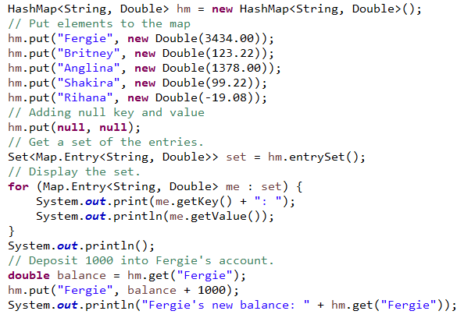
Program on HashMap

Slide 24


